Slide 1
Visual interpretation of various features and analysis of satellite data.

Slide 2
INTRODUCTION
Interpretation and analysis of remote sensing imagery involves the identification and/or measurement of various targets in an image or satellite image to extract useful information about them. Targets in remote sensing images may be any feature or object that can be observed in an image and have the following characteristics:
Targets may be a point, line, or area feature. This means that they can have any form, from a bus in a parking lot or a plane on a runway to a bridge or roadway to a large expanse of water or a field.
The target must be distinguishable and contrast with other features around it in the image.

Slide 3
Why Interpretation
Due to the different spatial and spectral resolutions of the remotely placed sensors, the information recorded by these sensors needs to be interpreted in a skilful manner with the desired accuracy
The human vision system has an inherent ability to sense, interpret and understand the object's reflectance appearing in the visible spectrum
Therefore, interpretation of remote sensing images is necessary to understand the object's properties and/or phenomenon

Slide 4
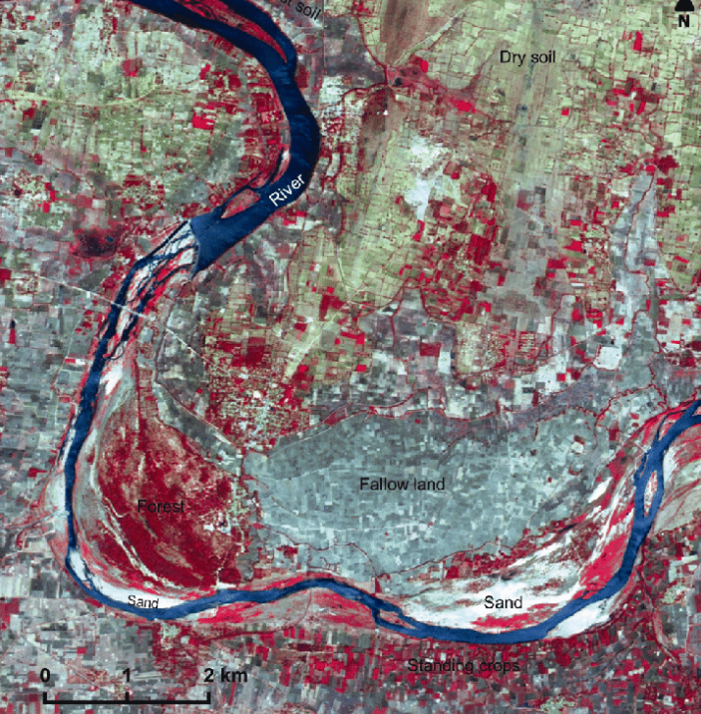

Slide 5
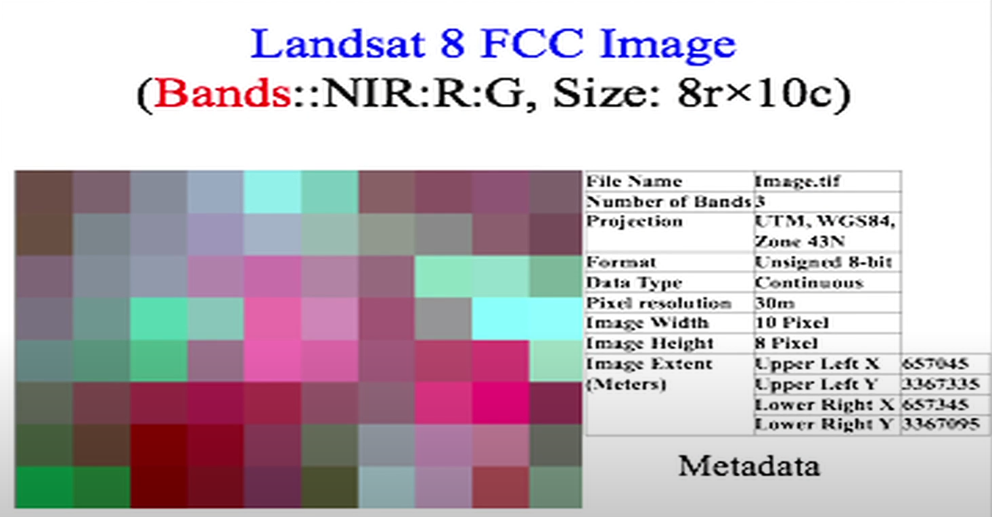

Slide 6
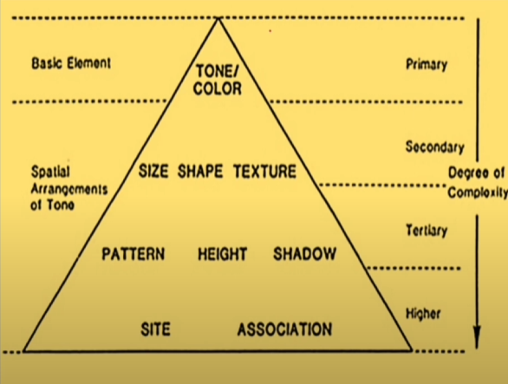
Interpretation Elements:
Key elements in the interpretation process include:
Tone/Color: Brightness or hue in the image.
Shape: The form of objects.
Size: Relative or absolute dimensions of objects.
Pattern: Spatial arrangement of objects.
Texture: Repetition of tonal variation.
Height: Relative or absolute height of objects, often inferred from shadows or stereo imagery.
Shadow: Clues about height or depth.
Site: Location characteristics (e.g., proximity to water, urban/rural context).
Association: Relationship with surrounding objects.

Slide 7
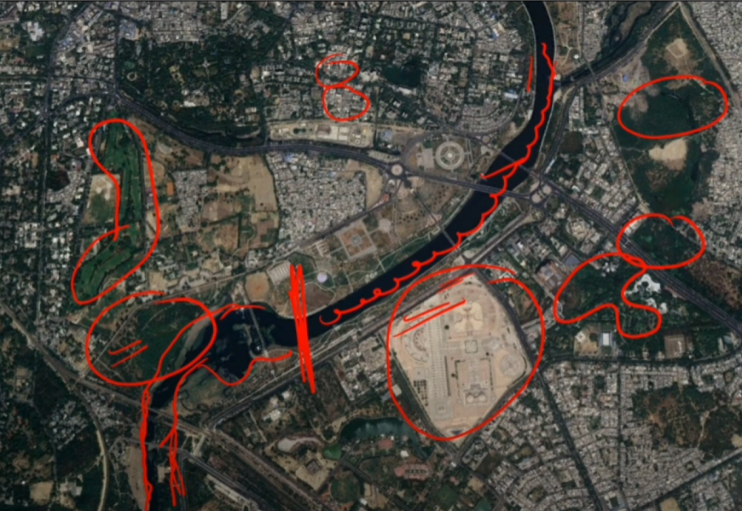
Tone/colour refers to the relative brightness or colour of objects in an image. Generally, tone is the fundamental element for distinguishing between different targets or features. Variations in tone also allow the elements of shape, texture, and pattern of objects to be distinguished.

Slide 8
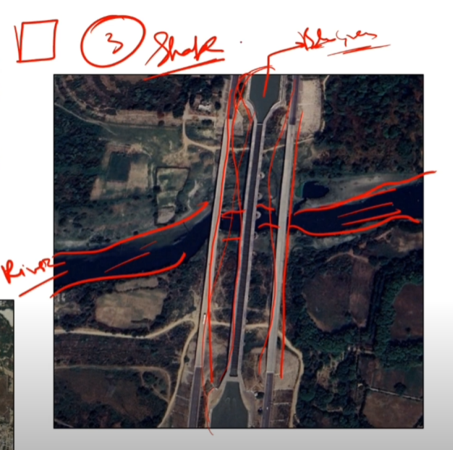
Shape refers to individual objects' general form, structure, or outline. The shape can be a very distinctive clue for interpretation. Straight edge shapes typically represent urban or agricultural (field) targets. In contrast, natural features, such as forest edges, are generally more irregular in shape, except where man has created a road or clearcuts. Farms or cropland irrigated by rotating sprinkler systems would appear in circular shapes.
Here, in the figure example, two water body features can be interpreted based on their shape: one is a river, and the other is an aqueduct.

Slide 9
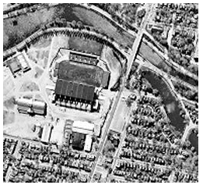
size of objects in an image is a function of scale. It is important to assess the size of a target relative to other objects in a scene and the absolute size to aid in interpreting that target. A quick approximation of target size can direct interpretation to an appropriate result more quickly. For example, if an interpreter had to distinguish zones of land use and had identified an area with several buildings, large buildings such as factories or warehouses would suggest commercial property, whereas small buildings would indicate residential use.

Slide 10
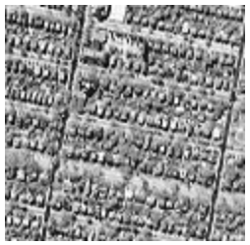
Pattern refers to the spatial arrangement of visibly discernible objects. Typically, an orderly repetition of similar tones and textures will produce a distinctive and ultimately recognizable pattern. Orchards with evenly spaced trees, and urban streets with regularly spaced houses are good examples of pattern.

Slide 11
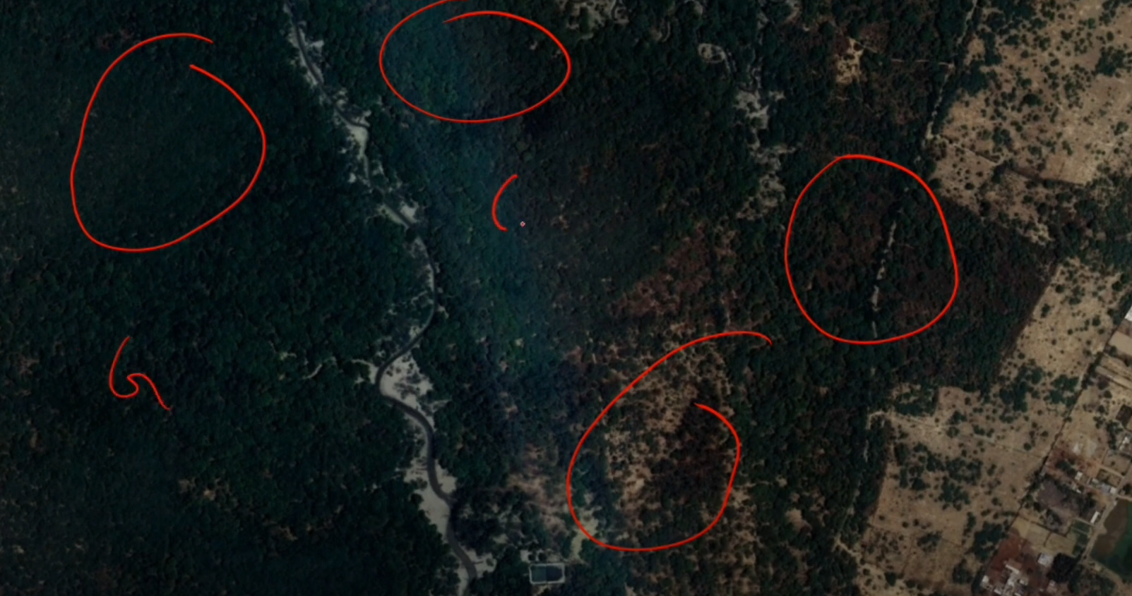
Texture refers to the arrangement and frequency of tonal variation in particular areas of an image. Rough textures would have a mottled tone, whereas smooth textures would have very little tonal variation. Smooth textures result most often from uniform, even surfaces, such as fields, asphalt, or grasslands. A target with a rough surface and irregular structure, such as a forest canopy, produces a rough texture. Texture is one of the most important elements for distinguishing features in radar imagery.

Slide 12
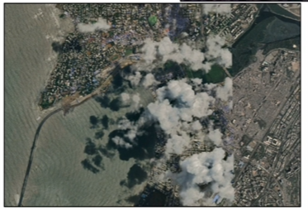
Shadow is also helpful in interpretation as it may provide an idea of the profile and relative height of a target or targets, which may make identification easier. However, shadows can also reduce or eliminate interpretation in their area of influence since targets within shadows are much less (or not at all) discernible from their surroundings. Shadow is also useful for enhancing or identifying topography and landforms, particularly in radar imagery.

Slide 13
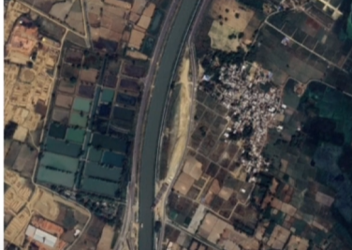
Association considers the relationship between other recognizable objects or features near the target of interest. The identification of features that one would expect to associate with other features may provide information to facilitate identification. In the example, Hatchery can be interpreted with the canal

Slide 14
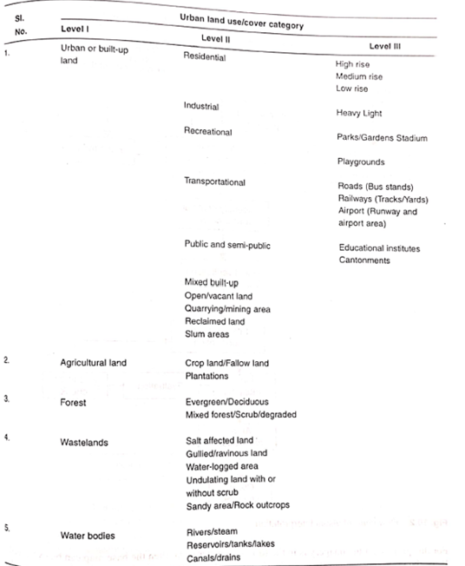
Classification levels

Slide 15
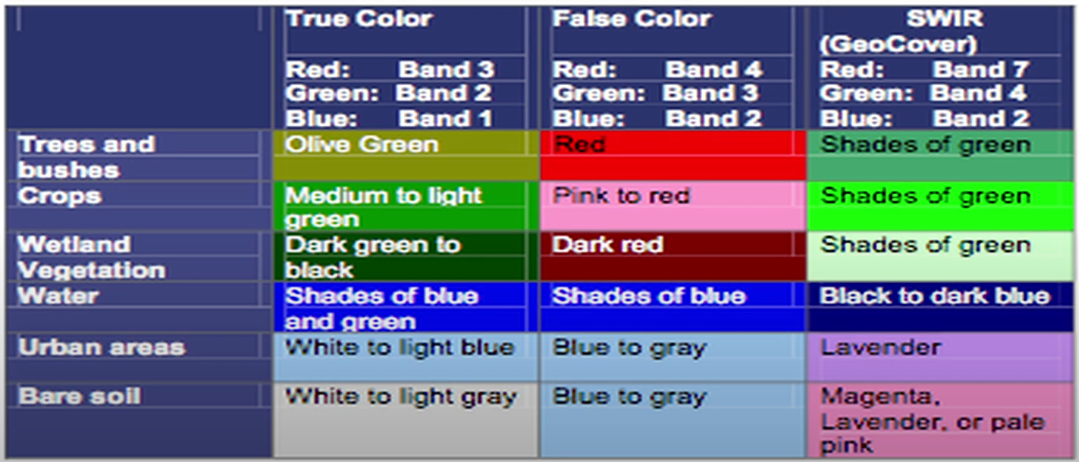
This table shows the Tones of Land Use/Land Cover appearing in different colours (SWAC, 2016). This depends on the spectral band combination and colors assigned.

Slide 16
Output/Result
Classified Map and Accuracy check of classified Map generated by you
Area Calculation and class statistics of classes decided by you and classified on a classified map

Slide 17
Exercise:
Generating a Stacked Product from Sentinel-2A Bands (2, 3, 4, and 8) and Visually Interpreting Features Using the Stacked Imagery.
Objective:
Compare the visual interpretation results with ground truth data (if available).
Generate a map of the interpreted features using your remote sensing software.

